Slide 1
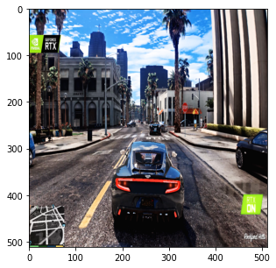
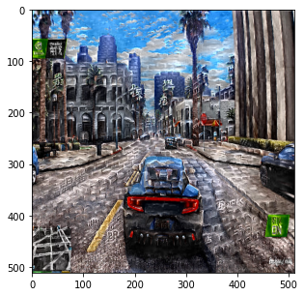

“brick style
painting”
GTA 5
GTA 5 in Brick Style
GameStyler: Enhanced UI design with Luminance only Style Transfer on a Single text condition
Aviral Chharia, Prakhar Bhardwaj, Shivam Doshi
24-787 Final Project Presentation
December 8th, 2022

Slide 2
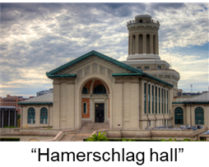
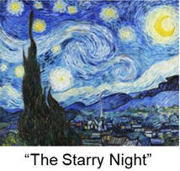
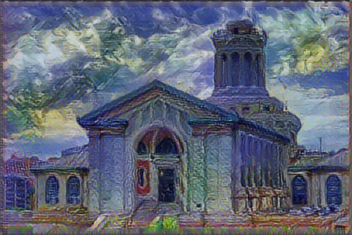
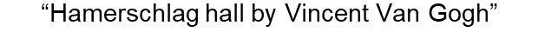

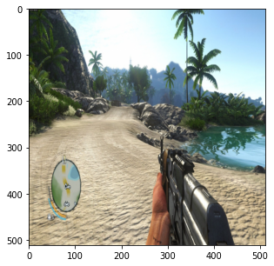
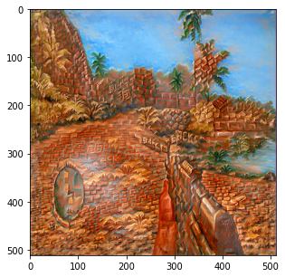
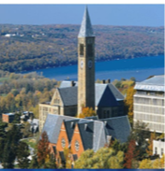
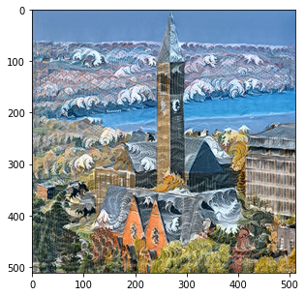
Challenges in applying Style Transfer for Visual Design
Two primary challenges are there in applying Neural Style Transfer to UI of Games for visual scene enhancement:
FryCry6.0
“Brick Style”
2) Style Image may not be always present with the Content Creator. However, they may have a visualization of the final image in their mind.
1) Loss of original color during Style Transfer

Slide 3
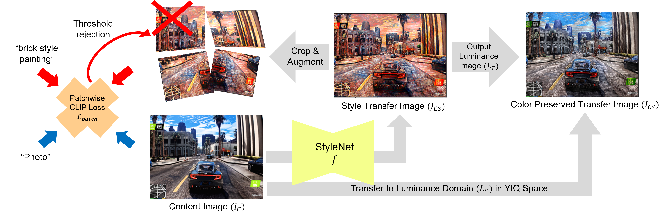
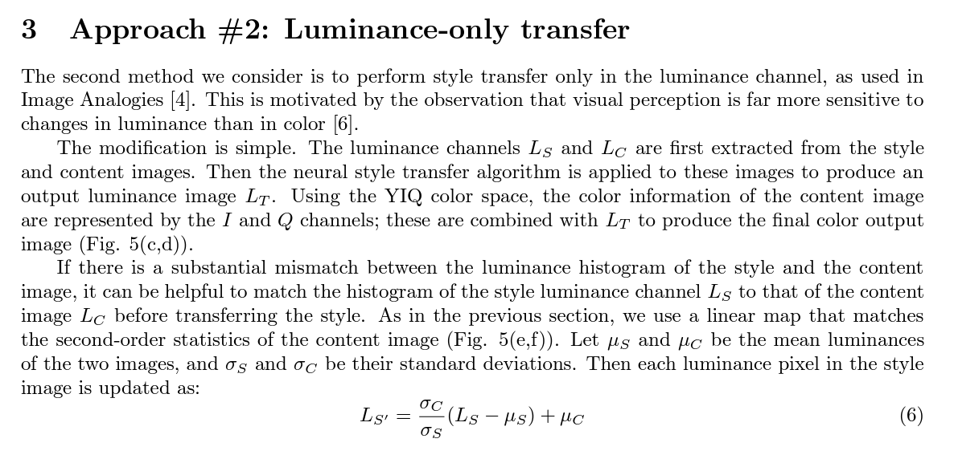
Model Overview

Slide 4
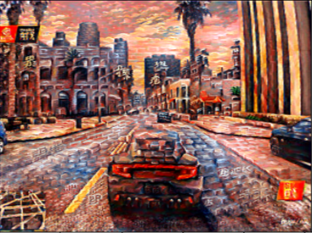
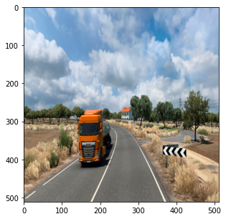
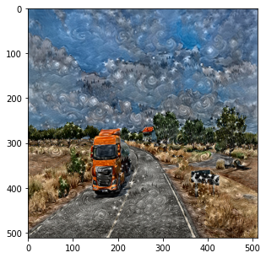
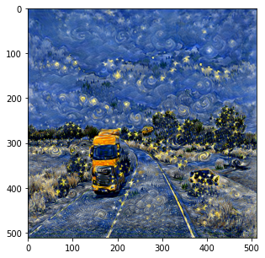
Results Obtained
GameStyler (Ours)
CLIPstyler (CVPR 22)
“brick style
painting”
GTA 5
GTA 5 in Brick Style
“Starry night by Vincent van gogh”
Euro Truck Simulator 2
Euro Truck Simulator 2 in Vincent Van Gogh’s Style

Slide 5
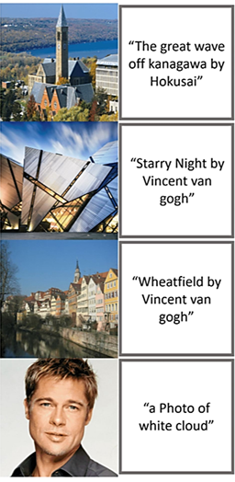
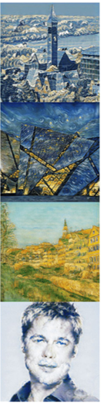
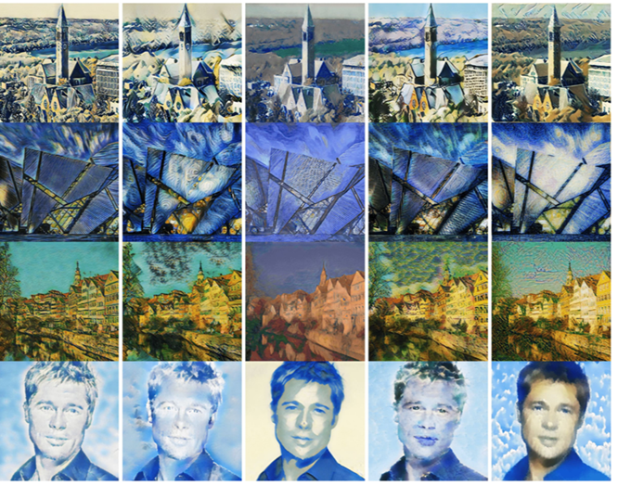
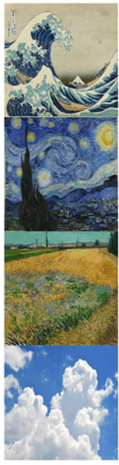
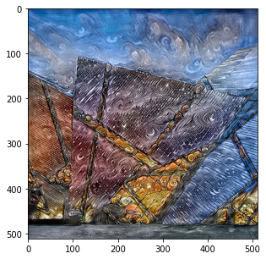
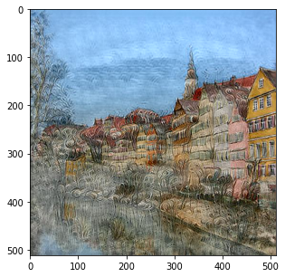
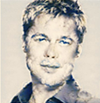
Comparison with State-of-the-art Models
Content Image
Text Condition
Ours
CLIPstyler
AdaAttn
SANet
CST
AdaIN
Gatys et al.
Style Image
CVPR 2022
ICCV 2021
CVPR 2019
CVPR 2020
ICCV 2017
CVPR 2016

Slide 6
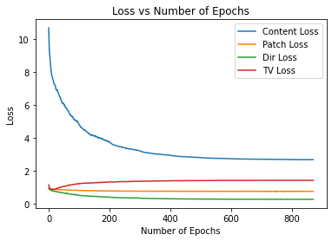
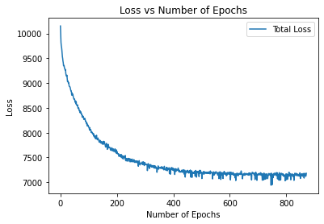

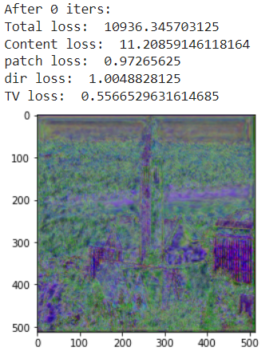
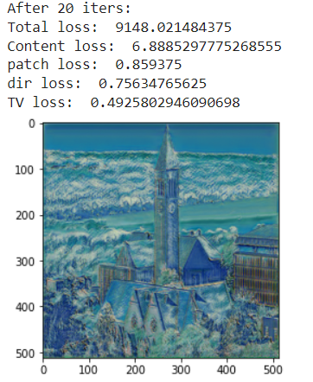
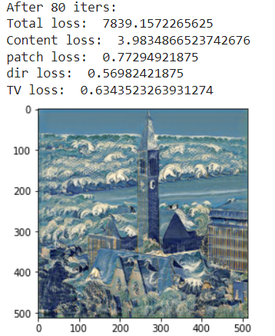
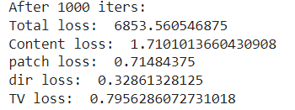
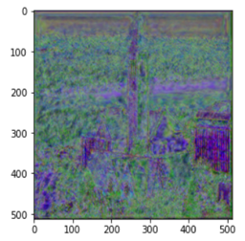
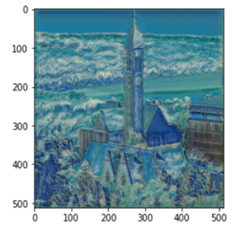
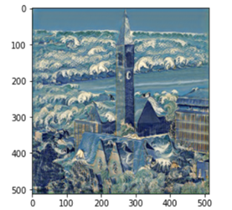
Quantitative Evaluation & Ablation Study
“The great wave off kanagawa by Hokusai”

Slide 7
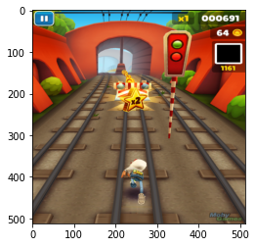
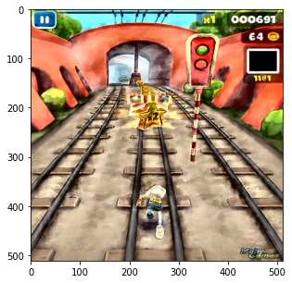
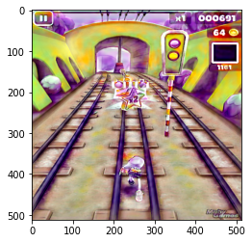
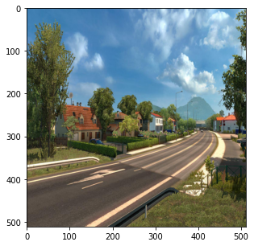
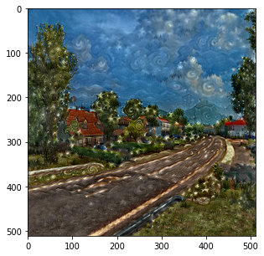
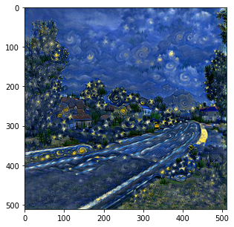
Additional Results
GameStyler (Ours)
CLIPstyler (CVPR 22)
“watercolor”
Subway Surfers
Subway Surfers in Watercolor Style
“Starry night by Vincent van gogh”
Euro Truck Simulator 2
Euro Truck Simulator 2 in Vincent Van Gogh’s Style

